Slide 1
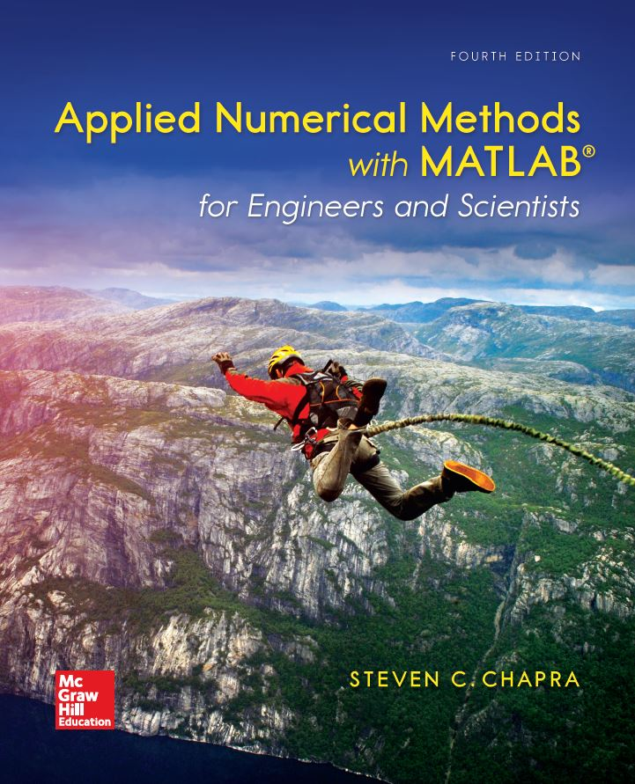
Part 3 Chapter 8
Linear Algebraic Equations and Matrices

Slide 2
Chapter Objectives
Understanding matrix notation.
Being able to identify the following types of matrices: identify, diagonal, symmetric, triangular, and tridiagonal.
Knowing how to represent a system of linear equations in matrix form.
Knowing how to solve linear algebraic equations with left division and matrix inversion in MATLAB.

Slide 3
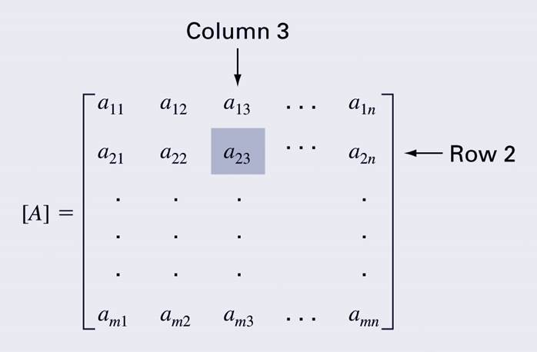
Overview, 1
A matrix consists of a rectangular array of elements represented by a single symbol (example: [A]).
An individual entry of a matrix is an element (example: a₂₃)

Slide 4
Overview, 2
A horizontal set of elements is called a row and a vertical set of elements is called a column.
The first subscript of an element indicates the row while the second indicates the column.
The size of a matrix is given as m rows by n columns, or simply m by n (or m x n).
1 x n matrices are row vectors.
m x 1 matrices are column vectors.

Slide 5
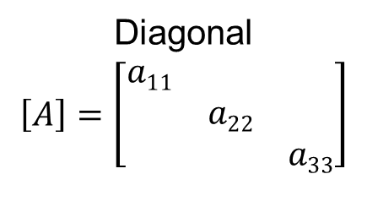
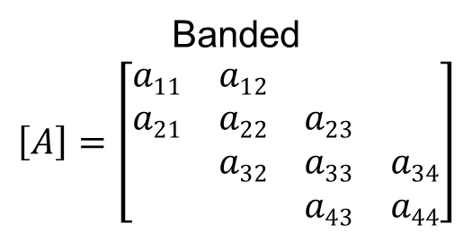
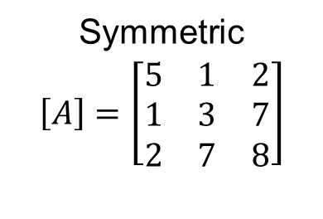
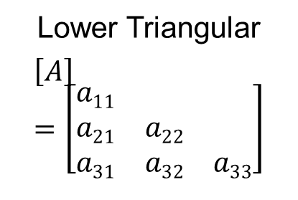
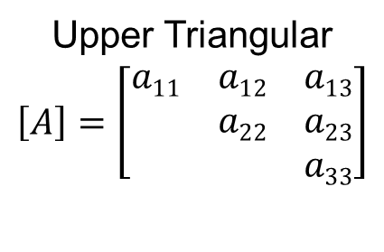
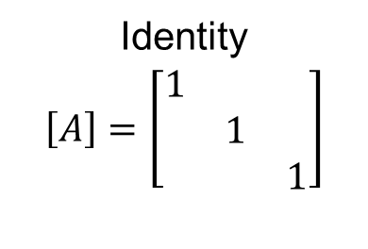
Special Matrices
Matrices where m=n are called square matrices.
There are a number of special forms of square matrices:
Symmetric
$$\left[A\right]=\left[\begin{matrix}5 & 1 & 2 \\ 1 & 3 & 7 \\ 2 & 7 & 8\end{matrix}\right]$$
Diagonal
$$\left[A\right]=\left[\begin{matrix}a11 & & \\ & a22 & \\ & & a33\end{matrix}\right]$$
Identity
$$\left[A\right]=\left[\begin{matrix}1 & & \\ & 1 & \\ & & 1\end{matrix}\right]$$
Upper Triangular
$$\left[A\right]=\left[\begin{matrix}a11 & a12 & a13 \\ & a22 & a23 \\ & & a33\end{matrix}\right]$$
Lower Triangular
$$\left[A\right]=\left[\begin{matrix}a11 & & \\ a21 & a22 & \\ a31 & a32 & a33\end{matrix}\right]$$
Banded
$$\left[A\right]=\left[\begin{matrix}a11 & a12 & & \\ a21 & a22 & a23 & \\ & a32 & a33 & a34 \\ & & a43 & a44\end{matrix}\right]$$

Slide 6
Matrix Operations
Two matrices are considered equal if and only if every element in the first matrix is equal to every corresponding element in the second. This means the two matrices must be the same size.
Matrix addition and subtraction are performed by adding or subtracting the corresponding elements. This requires that the two matrices be the same size.
Scalar matrix multiplication is performed by multiplying each element by the same scalar.

Slide 7
Matrix Inverse and Transpose
The inverse of a square, nonsingular matrix [A] is that matrix which, when multiplied by [A], yields the identity matrix.
[A][A]⁻¹=[A]⁻¹[A]=[I]
In Matlab: inv(A)
The transpose of a matrix involves transforming its rows into columns and its columns into rows.
(a_{ij})^{T}=a_{ji}
In Matlab: A'

Slide 8
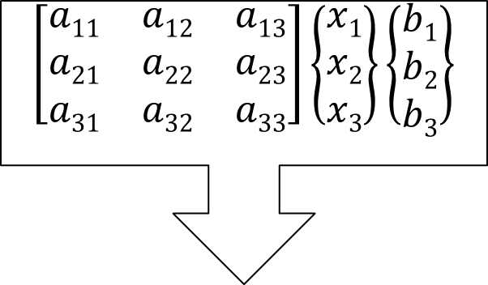
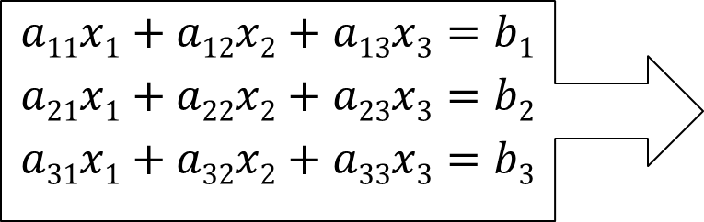
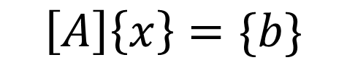
Representing Linear Algebra
Matrices provide a concise notation for representing and solving simultaneous linear equations:
$$a11x1+a12x2+a13x3=b1$$
$$a21x1+a22x2+a23x3=b2$$
$$a31x1+a32x2+a33x3=b3$$
$$\left[\begin{matrix}a11 & a12 & a13 \\ a21 & a22 & a23 \\ a31 & a32 & a33\end{matrix}\right]\left\{\begin{matrix}x1 \\ x2 \\ x3\end{matrix}\right\}\left\{\begin{matrix}b1 \\ b2 \\ b3\end{matrix}\right\}$$
$$\left[A\right]\left\{x\right\}=\{b\}$$

Slide 9

Matrix notation – solving system of linear equations
$$\left[A\right]\left\{x\right\}=\{b\}$$
$${\left[A\right]}^{−1}\left[A\right]\left\{x\right\}={\left[A\right]}^{−1}\left\{b\right\}$$
$$[I]\left\{x\right\}={\left[A\right]}^{−1}\{b\}$$
$$\left\{x\right\}={\left[A\right]}^{−1}\{b\}$$

Slide 10

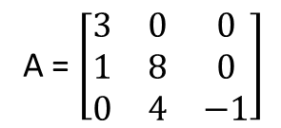
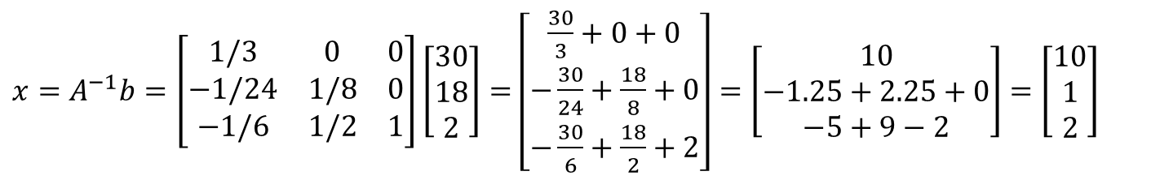
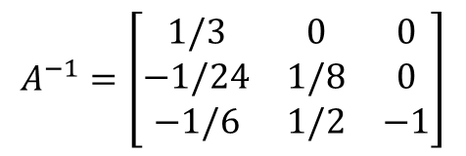
Example
A = $\left[\begin{matrix}3 & 0 & 0 \\ 1 & 8 & 0 \\ 0 & 4 & −1\end{matrix}\right]$
$$b=\left\{\begin{matrix}30 \\ 18 \\ 2\end{matrix}\right\}$$
$$A^{−1}=\left[\begin{matrix}1/3 & 0 & 0 \\ −1/24 & 1/8 & 0 \\ −1/6 & 1/2 & −1\end{matrix}\right]$$
${x=A}^{−1}b=\left[\begin{matrix}1/3 & 0 & 0 \\ −1/24 & 1/8 & 0 \\ −1/6 & 1/2 & 1\end{matrix}\right]\left[\begin{matrix}30 \\ 18 \\ 2\end{matrix}\right]=$ $\left[\begin{matrix}\frac{30}{3}+0+0 \\ −\frac{30}{24}+\frac{18}{8}+0 \\ −\frac{30}{6}+\frac{18}{2}+2\end{matrix}\right]=\left[\begin{matrix}10 \\ −1.25+2.25+0 \\ −5+9−2\end{matrix}\right]$ $=\left[\begin{matrix}10 \\ 1 \\ 2\end{matrix}\right]$

Slide 11
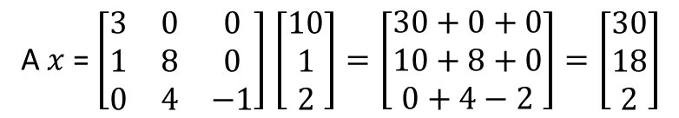
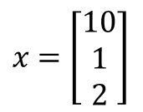
Example
A = $\left[\begin{matrix}3 & 0 & 0 \\ 1 & 8 & 0 \\ 0 & 4 & −1\end{matrix}\right]$
$$b=\left\{\begin{matrix}30 \\ 18 \\ 2\end{matrix}\right\}$$
$x$ $=\left[\begin{matrix}10 \\ 1 \\ 2\end{matrix}\right]$
(Test: “A x” must equal b)
A $x$ = $\left[\begin{matrix}3 & 0 & 0 \\ 1 & 8 & 0 \\ 0 & 4 & −1\end{matrix}\right]$ $\left[\begin{matrix}10 \\ 1 \\ 2\end{matrix}\right]=\left[\begin{matrix}30+0+0 \\ 10+8+0 \\ 0+4−2\end{matrix}\right]=\left[\begin{matrix}30 \\ 18 \\ 2\end{matrix}\right]$
(it seems our solution was correct)

Slide 12
Solving With MATLAB
MATLAB provides two direct ways to solve systems of linear algebraic equations [A]{x}={b}:
Left-division x = A\b
Matrix inversion x = inv(A)*b
The matrix inverse is less efficient than left-division and also only works for square, non-singular systems.

Slide 13
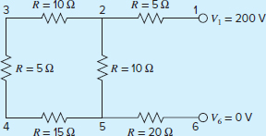
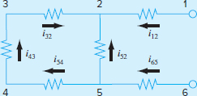
Case Study – currents and voltages in circuits
A common problem in electrical engineering involves determining the currents and voltages at various locations in resistor circuits. These problems are solved using Kirchhoff’s current and voltage rules. The current (or point) rule states that the algebraic sum of all currents entering a node must be zero. Write a Matlab program to find the current of the following circuit.
Given these assumptions, Kirchhoff’s current rule is applied at each node to yield

Slide 14
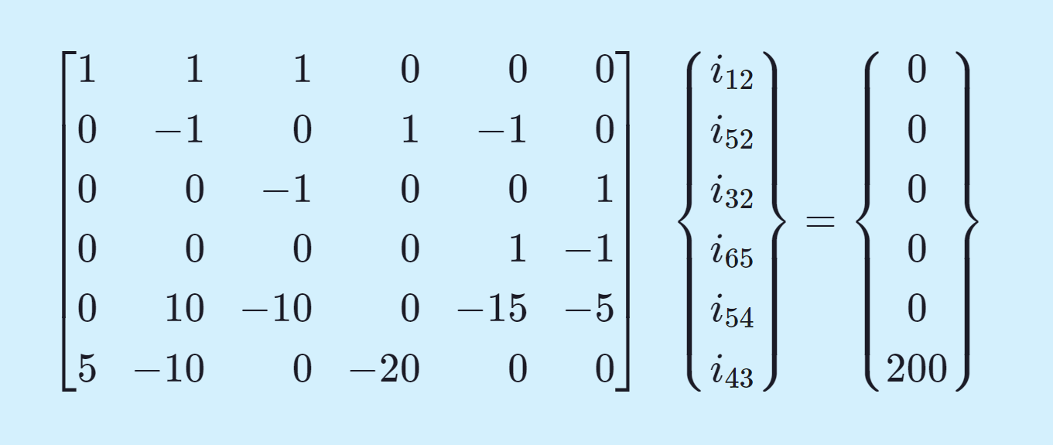
Case Study – currents and voltages in circuits
Given these assumptions, Kirchhoff’s current rule is applied at each node to yield
i₁₂ + i₅₂ + i₃₂ = 0
i₆₅ − i₅₂ − i₅₄ = 0
i₄₃ − i₃₂ = 0
i₅₄ − i₄₃ = 0
Application of the voltage rule to each of the two loops gives
−i₅₄R₅₄ − i₄₃R₄₃ − i₃₂R₃₂ + i₅₂R₅₂ = 0
−i₆₅R₆₅ − i₅₂R₅₂ + i₁₂R₁₂ − 200 = 0
or, substituting the resistances from Fig. 8.9 and bringing constants to the right-hand side,
−15i₅₄ − 5i₄₃ − 10i₃₂ + 10i₅₂ = 0
−20i₆₅ − 10i₅₂ + 5i₁₂ = 200
The six equations can be written compactly in a matrix as,

Slide 15

Example – problem 8.3
Write the following set of equations in matrix form:
$$50=5x_{3}−7x_{2}$$
$$4x_{2}+7x_{3}+30=0$$
$$x_{1}−7x_{3}=40 −3x_{2}+5 x_{1}$$
Use Matlab to solve for the unknown.

